Slide 1



Society Mirror
Analysis of Major Social Issues in Egypt (2018–2025)
Healthcare
Divorce
Homelessness
Education
Addiction

Slide 2





Team Members
Mayada Mohamed Konsowa
Mariam Mostafa Kamel
Rana Mabrouk Mahmoud
Tasneem Hassan Abdelfattah
Mayar Mohamed Elkhateb
Radwa Waleed Elsayed
Supervisor Company
Eng/ Eman Ghanem
ITC

Slide 3


Table of Contents
1
2
3
Introduction
Problem Statement
Project objectives
4
5
6
Scope of the Project
Data Collection
Data Cleaning
7
8
9
Proposed Solution
System Design
Project's features
10
11
12
Insights
Recommendations
Conclusion

Slide 4



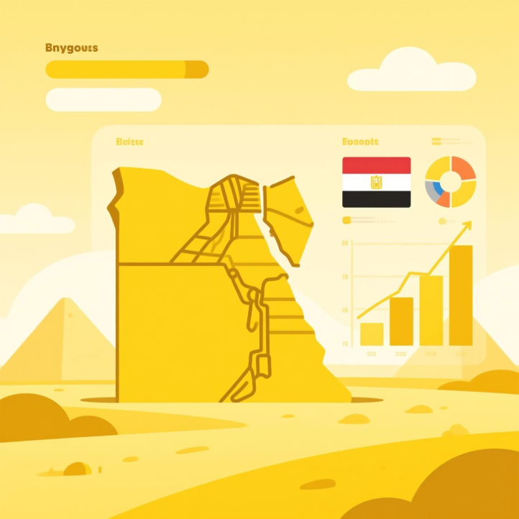
Introduction
Social issues represent a major challenge for communities, influencing stability, development, and overall quality of life. Over the past five years, Egypt has witnessed notable fluctuations in several key societal indicators. The idea of this project is inspired by Egypt’s Vision 2030, which places social development at the heart of its strategic objectives. The vision emphasizes improving citizens’ well-being, reducing inequalities, strengthening public services, and ensuring a more inclusive and sustainable society. By analyzing major social issues such as divorce, drug addiction, homelessness, education, and healthcare, this project aims to deliver a unified, data-driven overview that supports decision-makers in developing targeted interventions. Through visualization, exploration, and trend analysis, the project seeks to highlight patterns, identify critical areas, and provide actionable insights aligned with the goals of Egypt’s Vision 2030.

Slide 5



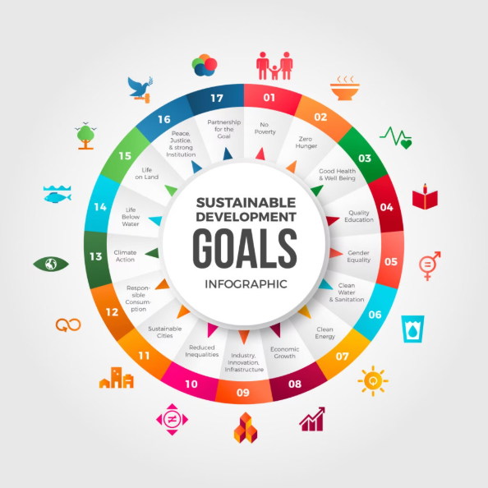
Introduction
In this project, we aligned our work with Egypt’s Vision 2030 and the Sustainable Development Goals.Our analysis directly contributes to several SDGs, including:
Goal 1: No Poverty
Goal 2: Zero Hunger (if relevant to homelessness/social vulnerability)
Goal 3: Good Health and Well-Being
Goal 4: Quality Education
Goal 8: Decent Work and Economic Growth
Goal 11: Sustainable Cities and Communities (related to homelessness and social issues)
Our dataset covers key social challenges faced by Egyptian youth between 2018 and 2025, including health, education, divorce, homelessness, and addiction. By analyzing these issues, we aimed to highlight real patterns and support data-driven decision-making that aligns with Egypt’s national development goals.

Slide 6




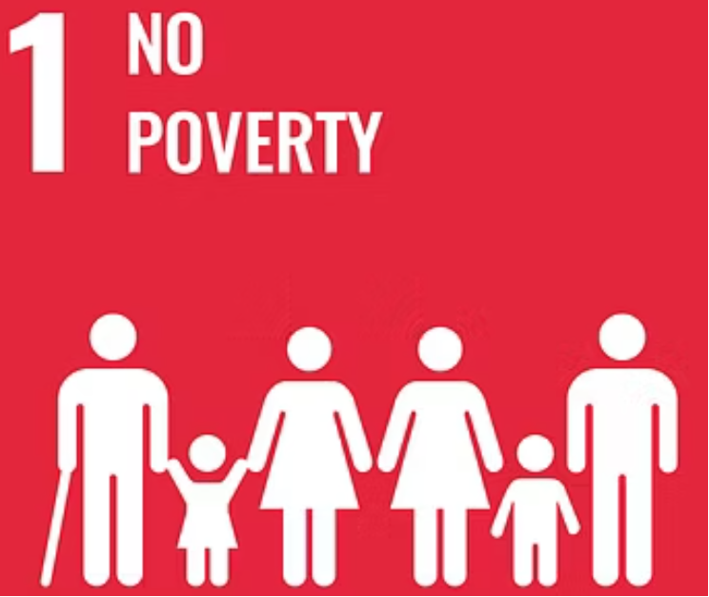
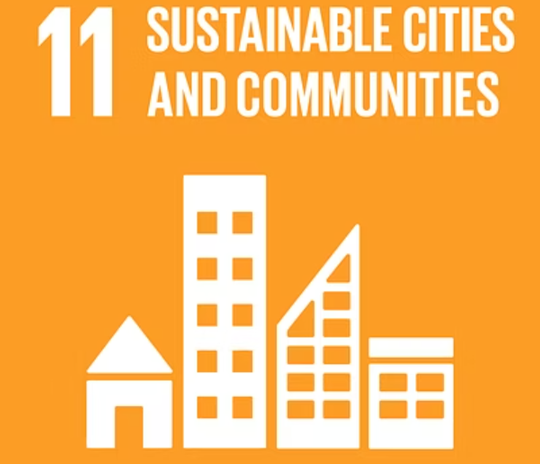

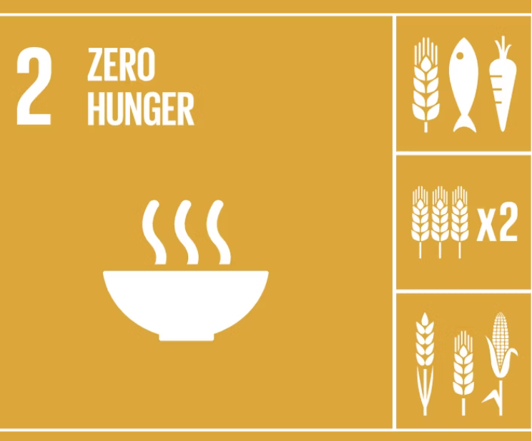
Sustainable Development Goals
Our project directly contributes to the highlighted goals aligned with Egypt's Vision 2030.

Slide 7





Problem Statement
Fragmented Data :
Existing raw data is abundant but often disparate, lacking a unified comparative analysis across critical social issues.
Decision-Making Gap :
Policymakers and stakeholders require clear, actionable data to inform strategic decisions and allocate resources effectively.

Slide 8


Project Objectives
Analyze social issue trends from 2018–2025
Identify significant spikes and correlations
Provide data-based recommendations for action
1
2
3
4
5
Compare trends across various governorates
Build interactive and insightful dashboards

Slide 9







Scope of the Project
Divorce Cases
Homelessness
Education
Examining trends and regional disparities.
Understanding the scope and contributing factors.
Assessing key metrics and challenges.
Healthcare & BMI
Addiction
Evaluating public health data and Body Mass Index.
Mapping geographic and gender-based patterns.
Includes yearly and governorate-level comparisons, with comprehensive dashboards and Key Performance Indicators (KPIs).

Slide 10


Data Description (Data Dictionary)
Our analysis draws upon a diverse range of reliable sources to ensure accuracy and breadth:
Central Agency for Public Mobilization and Statistics (CAPMAS)
Ministry of Health (MoH)
WHO Egypt health profile.
100 Million Healthy and population_Egypt.
World Bank
Tobacco atlas
State of global air
Egypt national hypertension
Ministry of Education (MoE)
UNICEF reports and relevant surveys
The dataset covers a critical period from 2018 to 2024, providing a longitudinal perspective on social issues. Key variables include demographic data, social metrics, economic indicators, and health statistics.

Slide 11



Data Collection
Source Identification
1
Key data sources like CAPMAS, MoH, and MoE were identified as primary information providers.
2
Manual Extraction
Due to the varied formats, much of the data required manual extraction from reports and databases.
Standardization Challenges
3
Overcoming inconsistencies in data formats and definitions across sources was a significant hurdle.
4
Consolidated Dataset
The process culminated in a unified and standardized dataset ready for analysis.
AI-Based Simulation
5
Augmented the dataset using AI to simulate additional data based on real-world statistics.
6
Survey
Simulation ensured representative trends and supported predictive analysis
In addition to secondary sources, a survey was designed and conducted by our team to collect

Slide 12


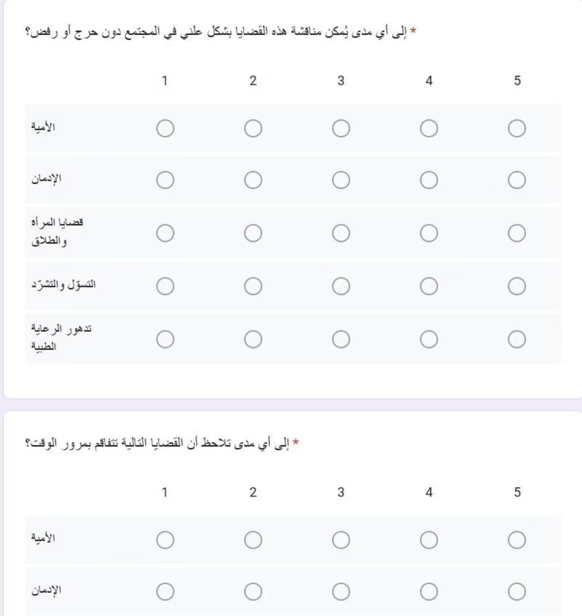
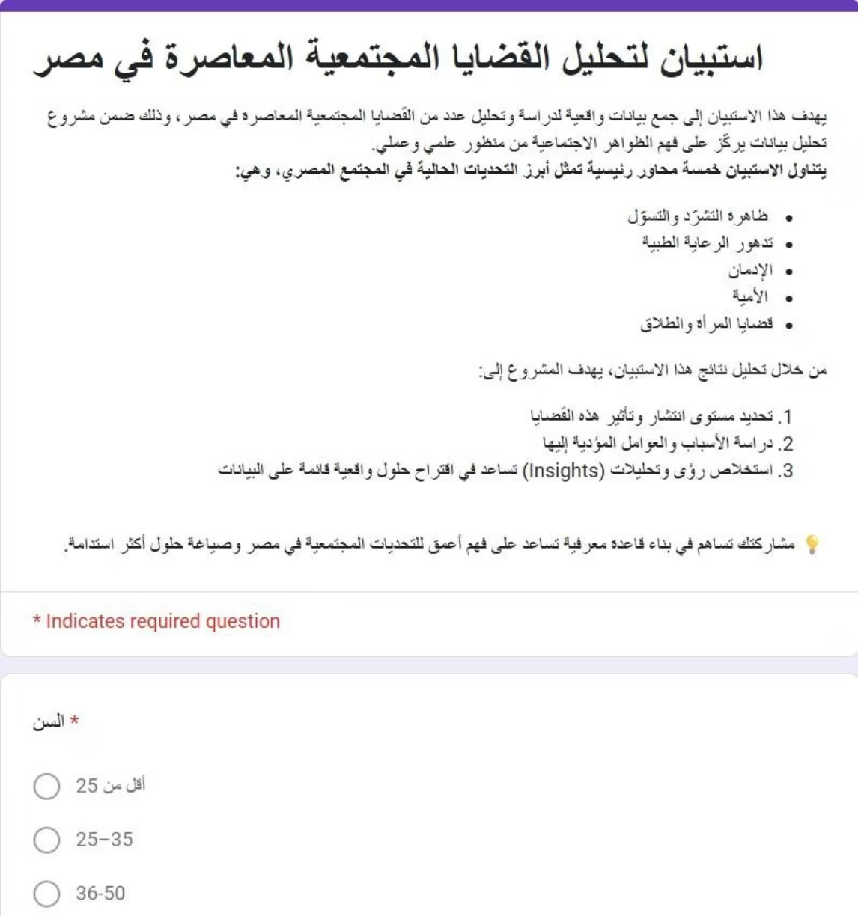
Our Survey

Slide 13


Data Cleaning & Preprocessing
Raw data, while rich, often contains inconsistencies and errors that can skew analysis. Our rigorous data cleaning and preprocessing steps ensure the integrity and reliability of our findings.
Missing Values
1
Implemented strategies for imputation and handling incomplete data points.
2
Outlier Detection
Identified and addressed extreme values that could distort statistical models.
Format Unification
3
Standardized data types, units, and categories for consistent analysis.
4
Error Correction
Systematic identification and rectification of data entry or collection errors.

Slide 14


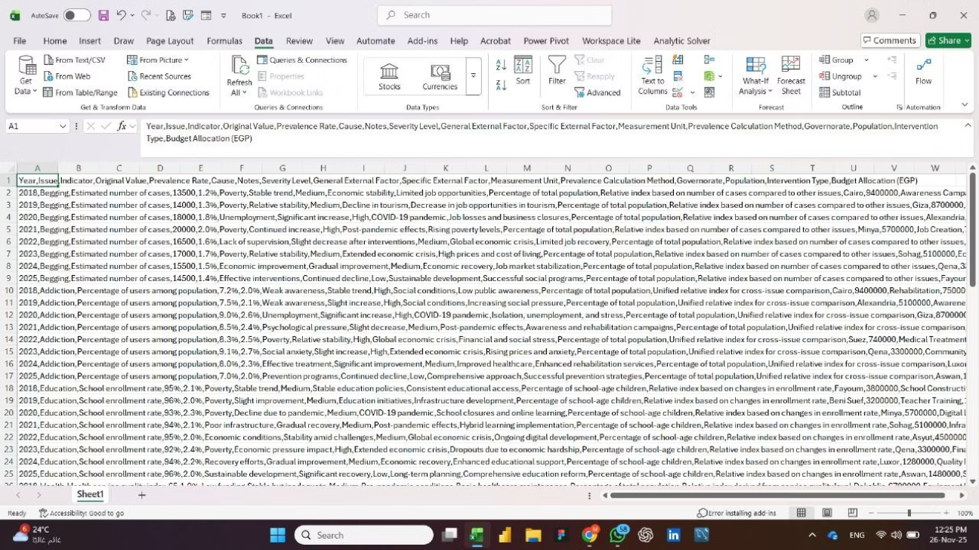
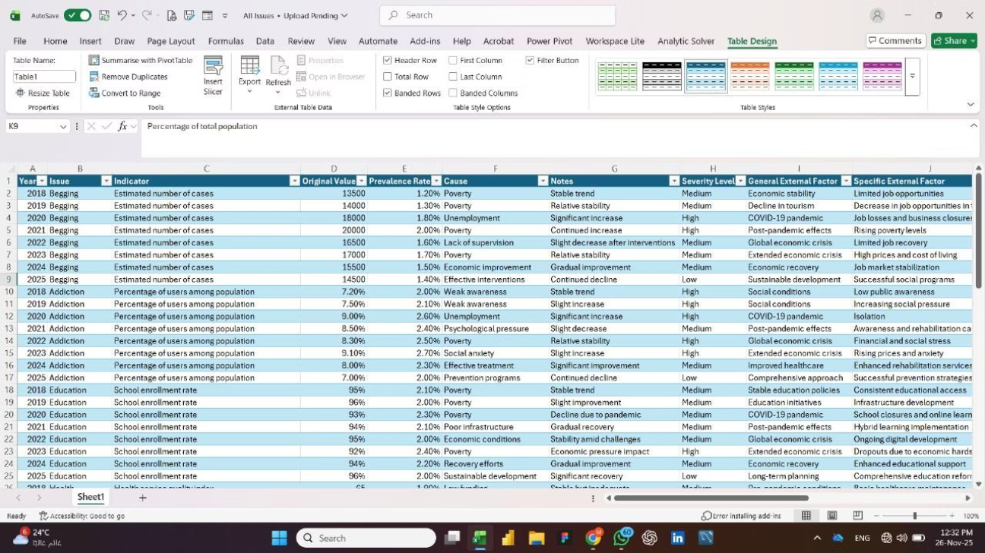
Data Cleaning (Tools used)
*Power Query for data extraction, transformation, and initial cleaning.
Before
After

Slide 15


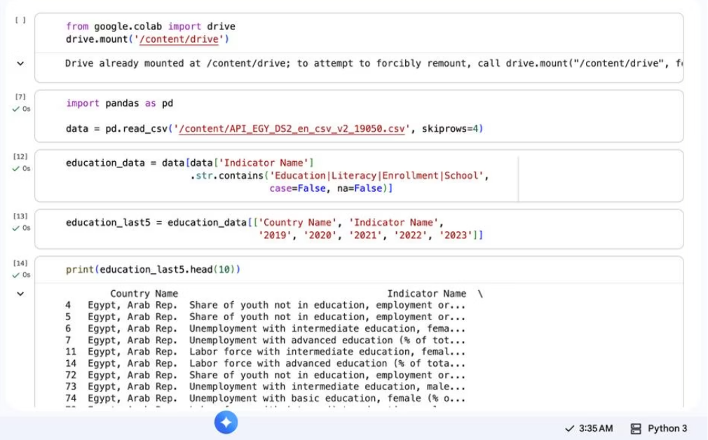
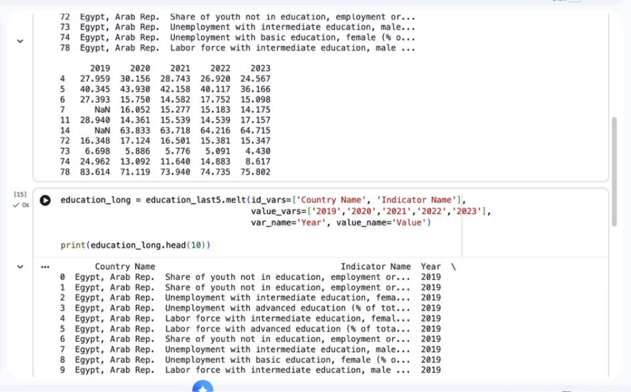
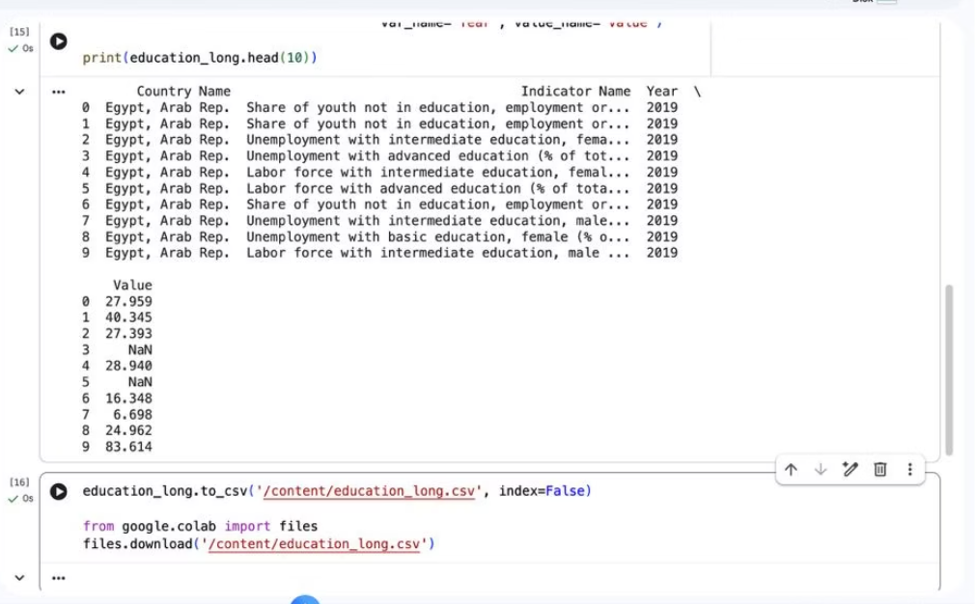
Data Cleaning (Tools used)
*Python (pandas & numpy) for advanced preprocessing, handling missing data, and merging multiple sources.

Slide 16


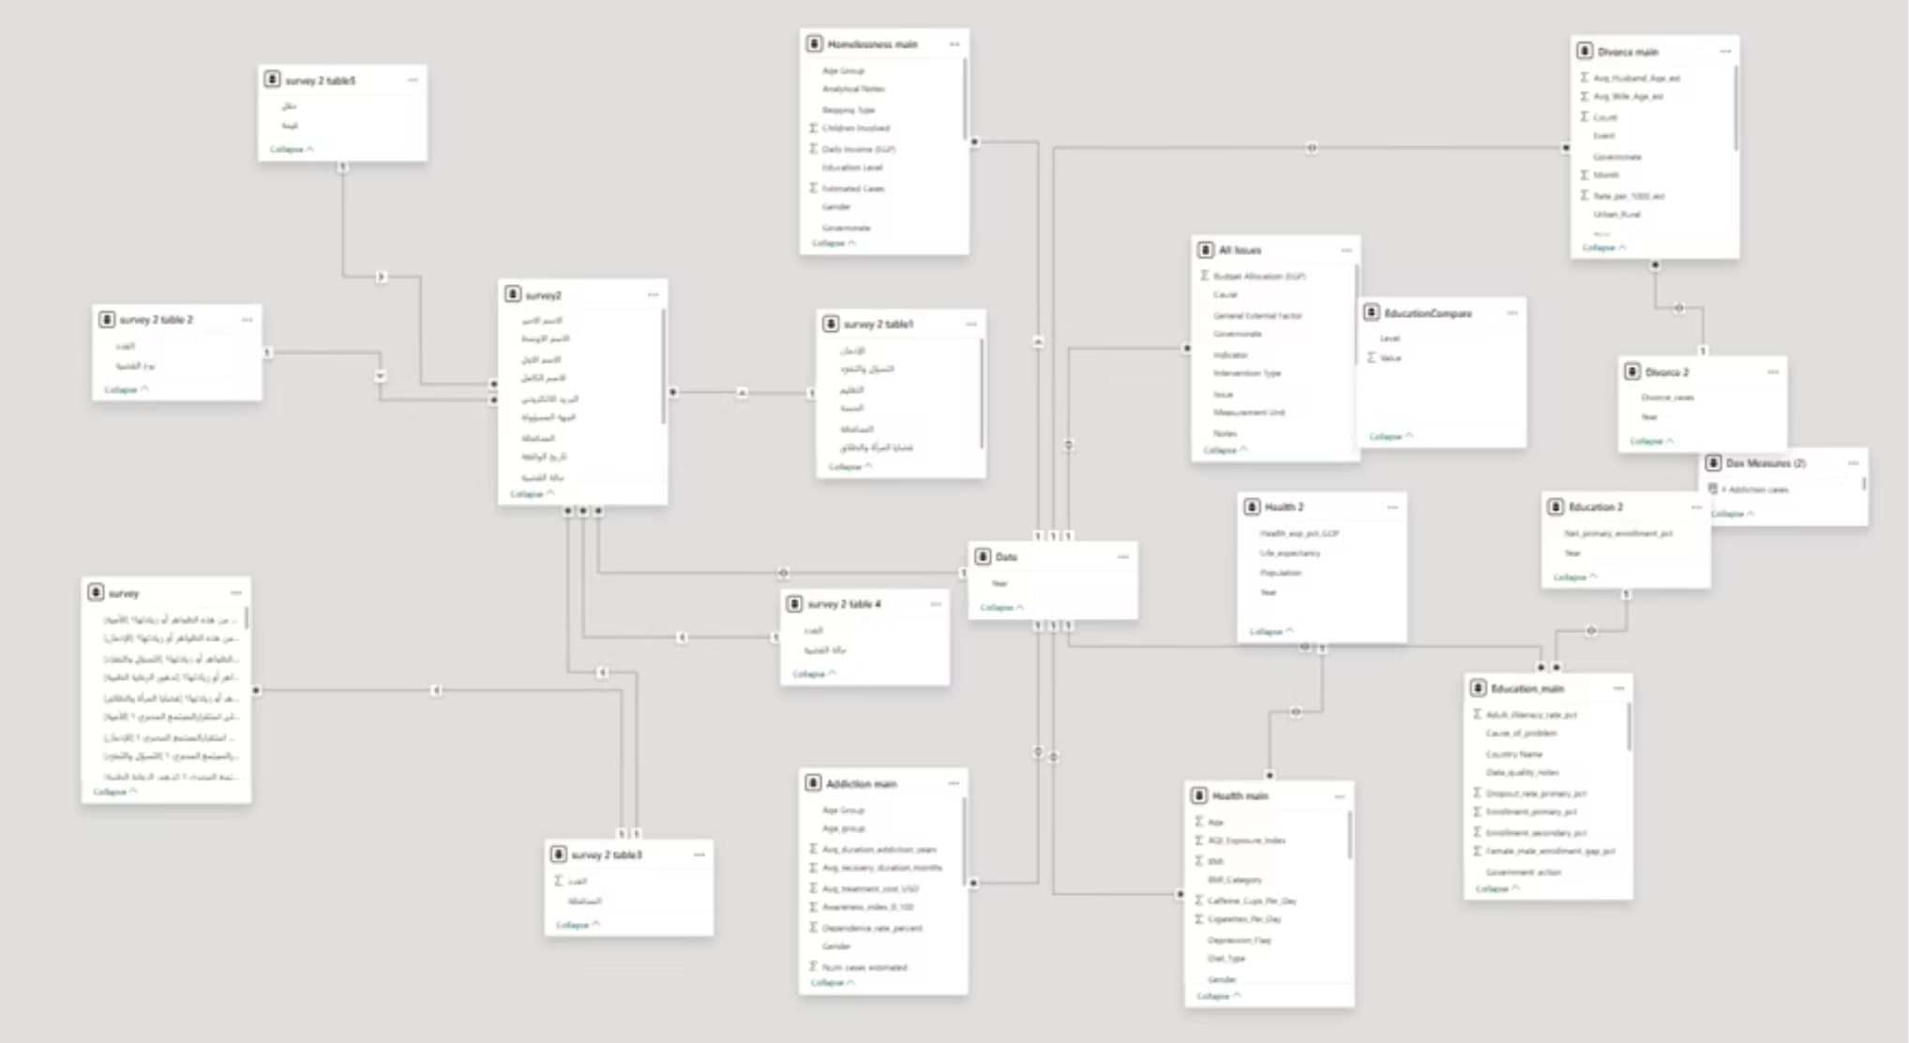
Data Modeling
A Snowflake Schema was designed to normalize the dimension tables, reduce redundancy, and improve data consistency

Slide 17













Proposed Solution
Data IntegrationCollected and unified data from multiple official sources (CAPMAS, MOH, MOE, surveys)
Data Cleaning & PreprocessingRemoved duplicates, handled missing values, standardized labels, and created calculated fields.
Scalable Analytical ModelDesigned a flexible framework that can be updated annually or expanded to new social indicators.
Data Pipeline DevelopmentUsed Power Query and Python to automate extraction, transformation, and merging of datasets.
8
Recommendation FrameworkDeveloped data-driven recommendations tailored to each social issue.
7
4
Exploratory Data Analysis (EDA)Identified trends, patterns, spikes, and governorate-level differences across all social issues.
6
5
Insights ExtractionHighlighted key findings across divorce, addiction, homelessness, education, and healthcare.
Dashboard Development (Power BI)Built interactive visual dashboards with filters, KPIs, and comparative charts for clear insights.

Slide 18


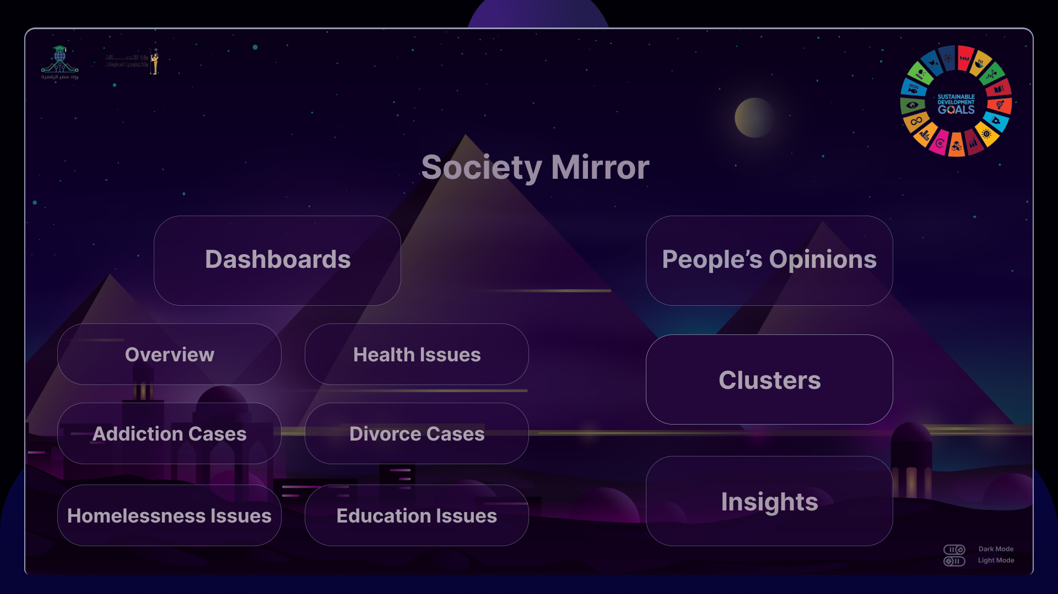
System Design
Architecture
Click here to open the project
Components
Data Sources (CAPMAS, MOH, MOE, Surveys)
Data Ingestion (Power Query, Python scripts)
Data Cleaning & Preprocessing (Duplicates removal, missing values, standardization)
Data Storage (Unified structured dataset)
Analysis Layer (EDA, trends, patterns, comparisons)
Visualization Layer (Power BI dashboards, KPIs, interactive filters)
Recommendation Layer (Insights + strategic actions)
Data Flow
Collect data from official sources
Load data using Power Query / Python
Clean & preprocess datasets
Merge & standardize into a single model
Run EDA to detect trends and anomalies
Build dashboards in Power BI
Extract insights and generate recommendations
Publish final report & dashboard

Slide 19


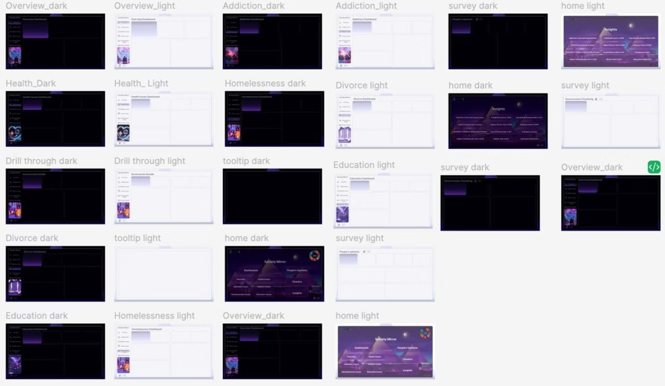
Project's features
✨ Key Project Features & Advanced Enhancements ✨
1. Figma Design (Dark & Light Themes) Designed custom dashboard backgrounds using Figma. Provided both Dark and Light themes for enhanced user experience.

Slide 20
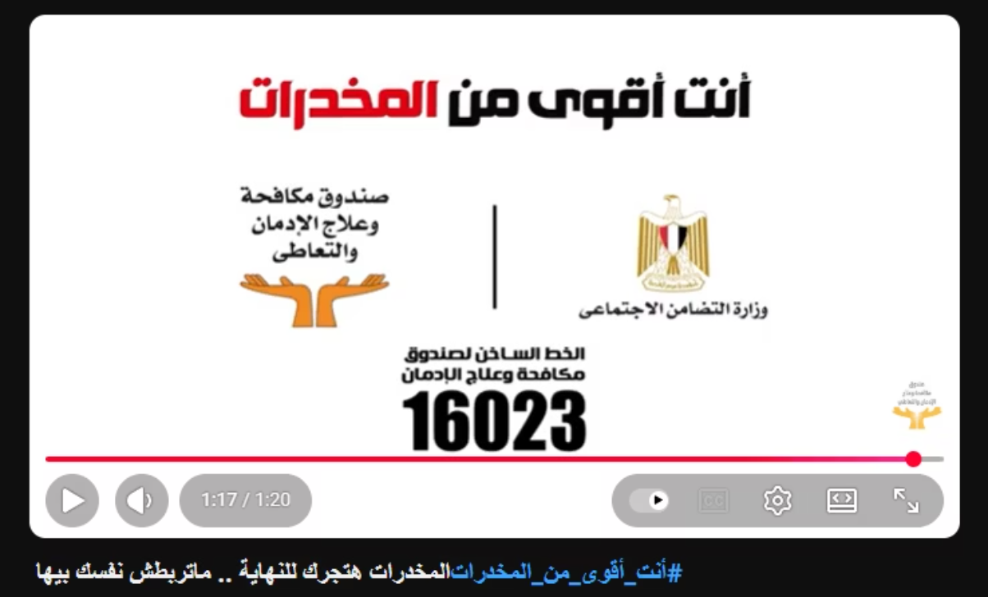
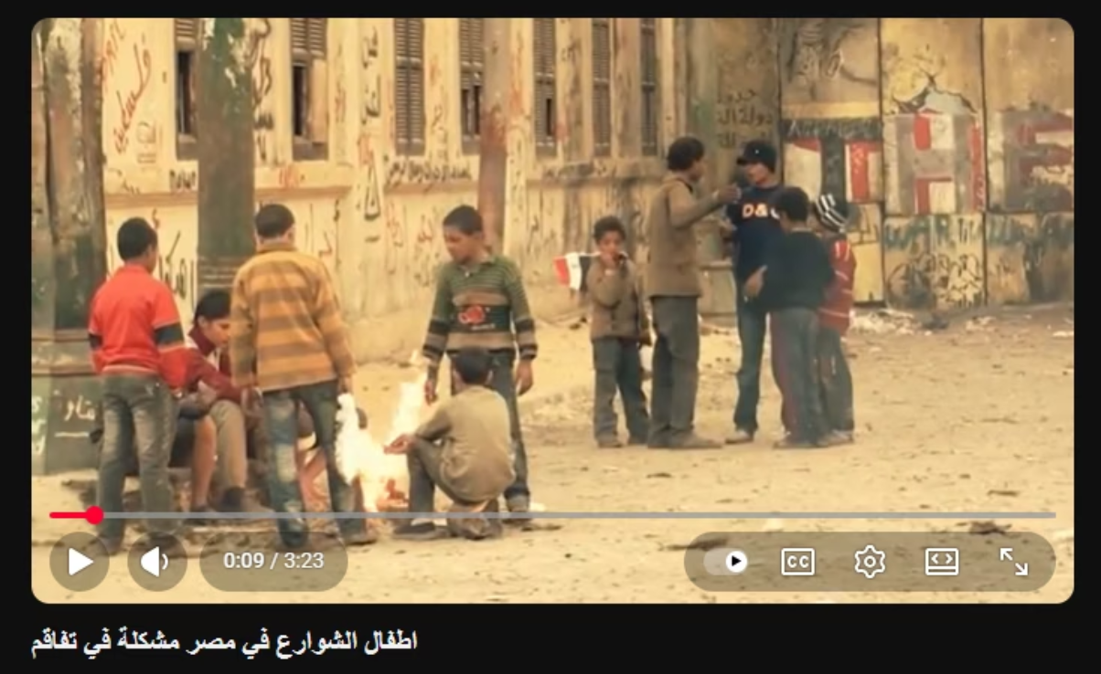
Project's features
2. Awareness Video Integration Added a dedicated section to display awareness videos inside Power BI. Embedded external content to support the social-impact message of the project.

Slide 21
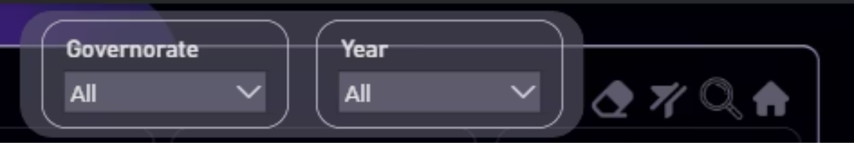
Project's features
3. Advanced Filters & Bookmarks Implemented advanced filters to improve interactivity. Created bookmarks for quick navigation between analytical scenarios.

Slide 22

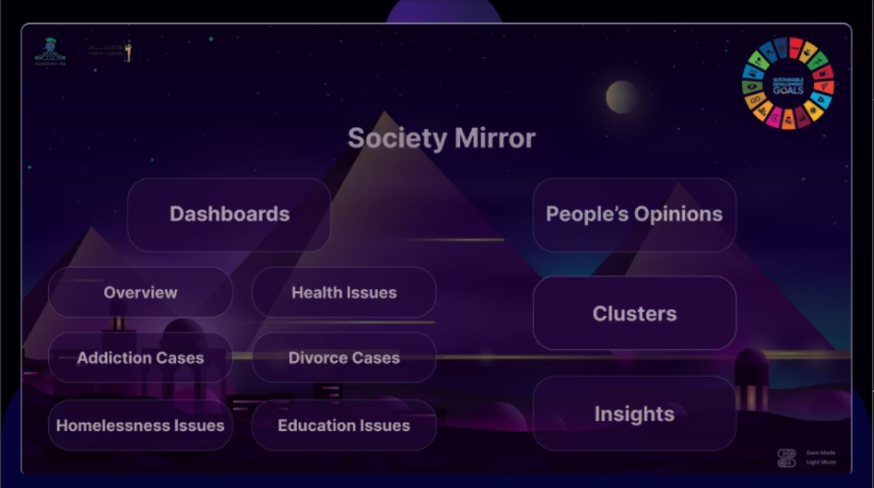
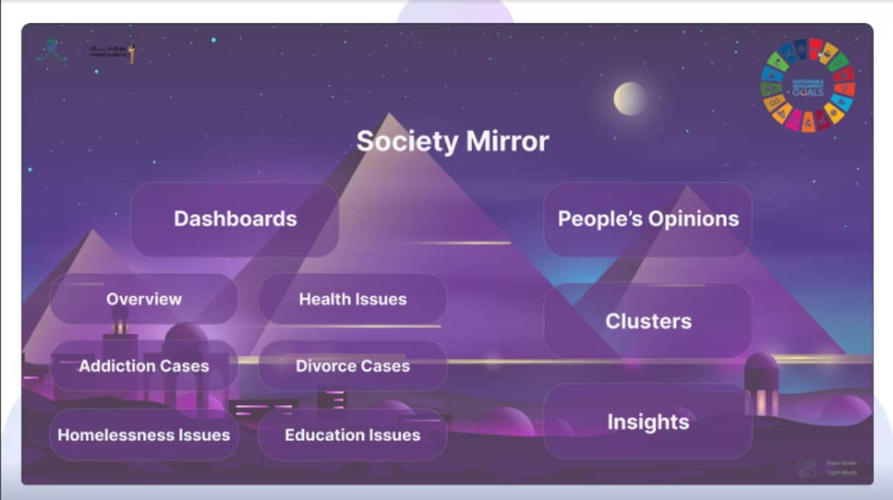
Project's features
4. Home Page & Insights Page Developed a Home page to act as a navigation hub. Built an Insights page summarizing key findings, KPIs, and recommendations.

Slide 23
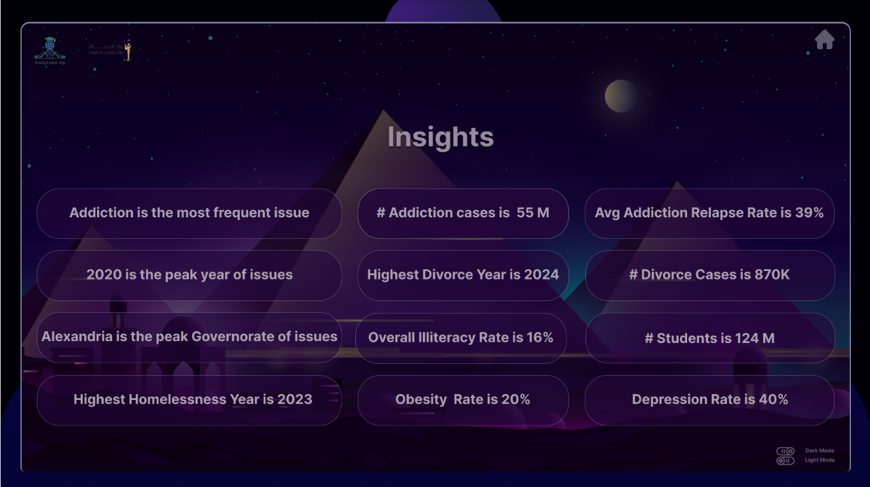
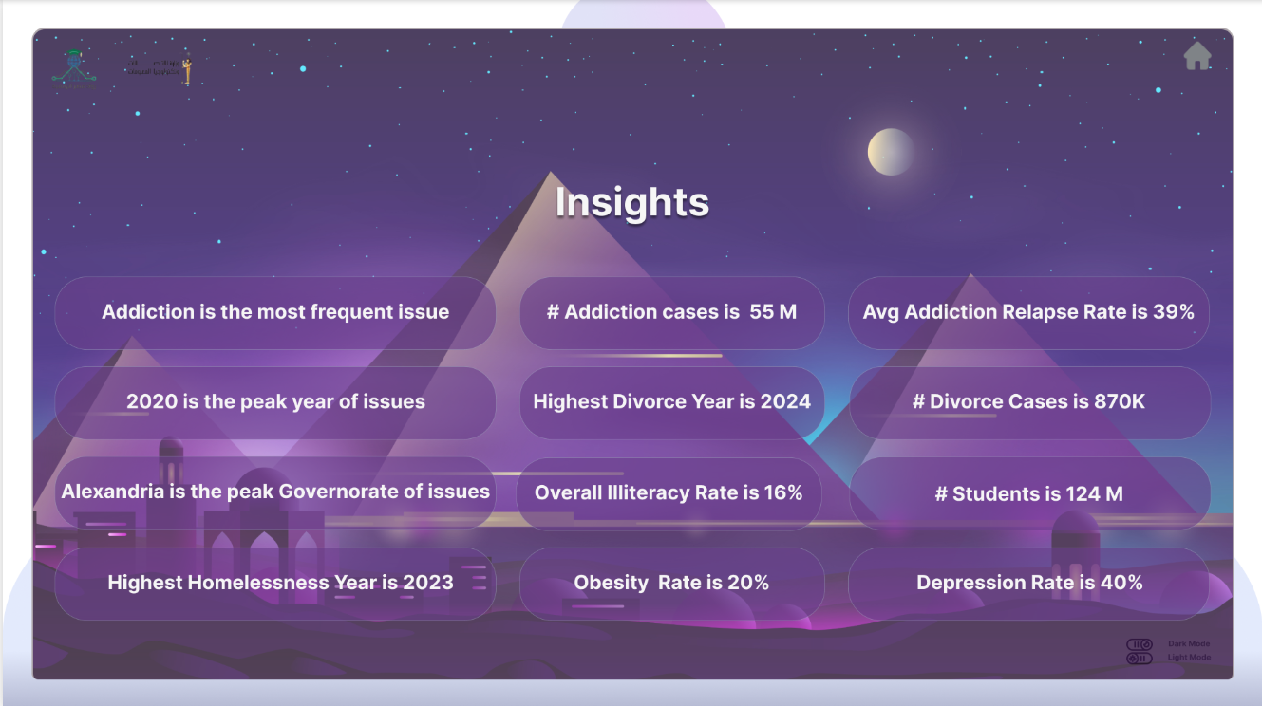
Project's features
4. Home Page & Insights Page Developed a Home page to act as a navigation hub. Built an Insights page summarizing key findings, KPIs, and recommendations.

Slide 24

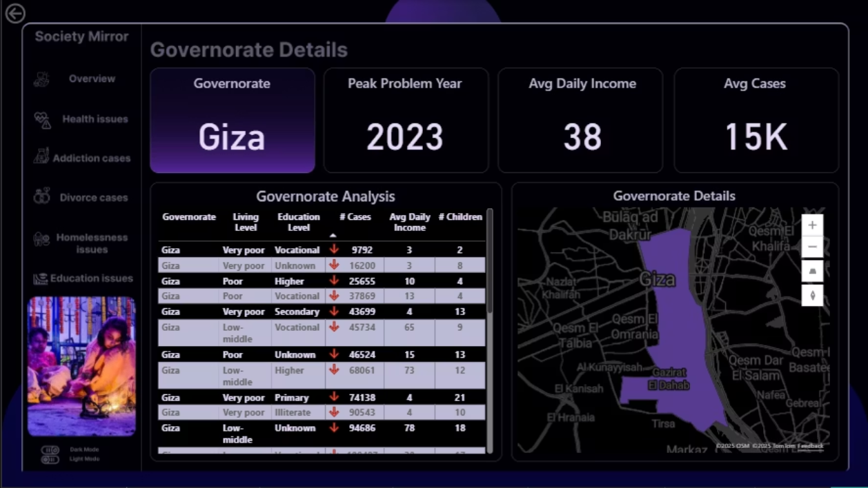
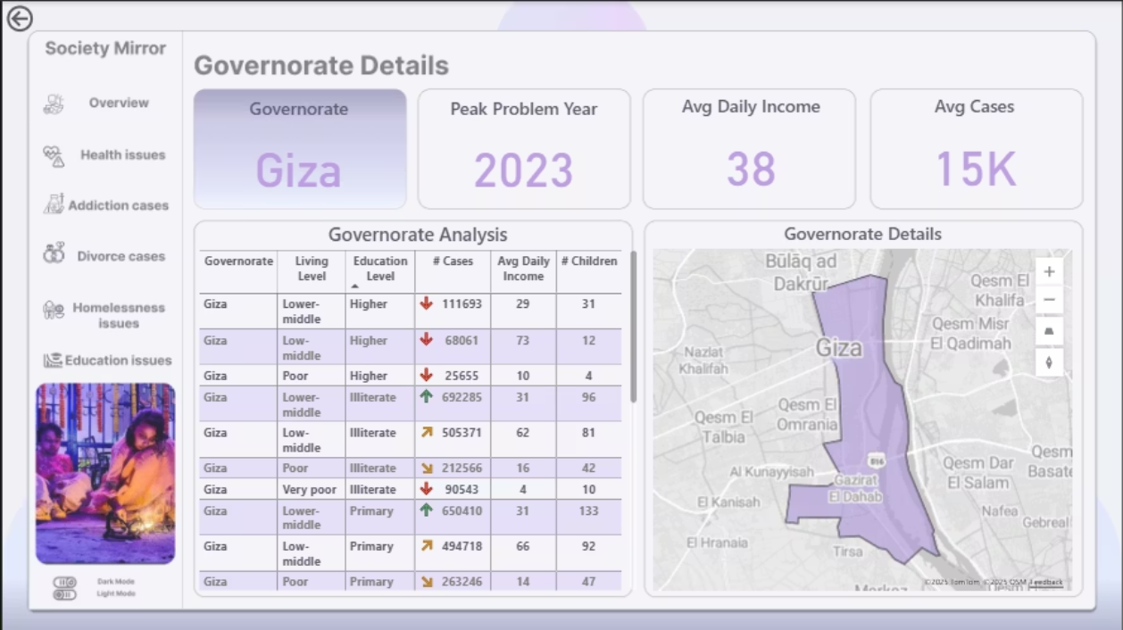
Project's features
5. Drill Down & Drill Through Enabled deeper exploration of the data through multiple hierarchy levels. Added Drill Through pages for detailed analysis based on user selections.

Slide 25

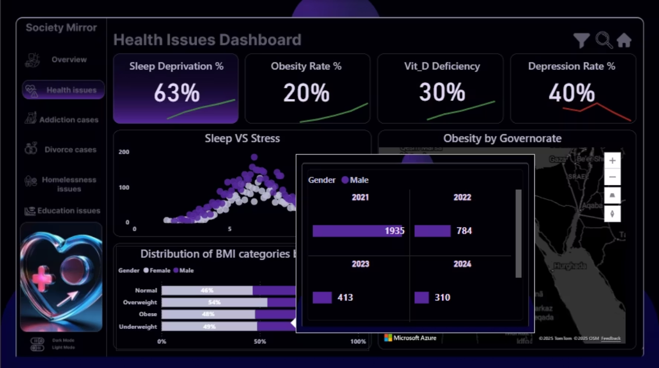
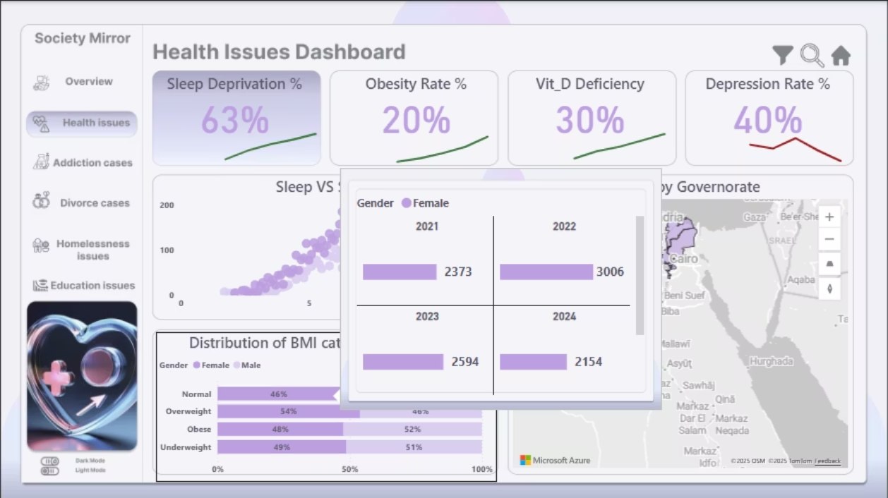
Project's features
6. Interactive Tooltips (Hover) Added hover-based tooltips that reveal extra information. Helps keep the dashboard clean while providing deeper insights on demand.

Slide 26

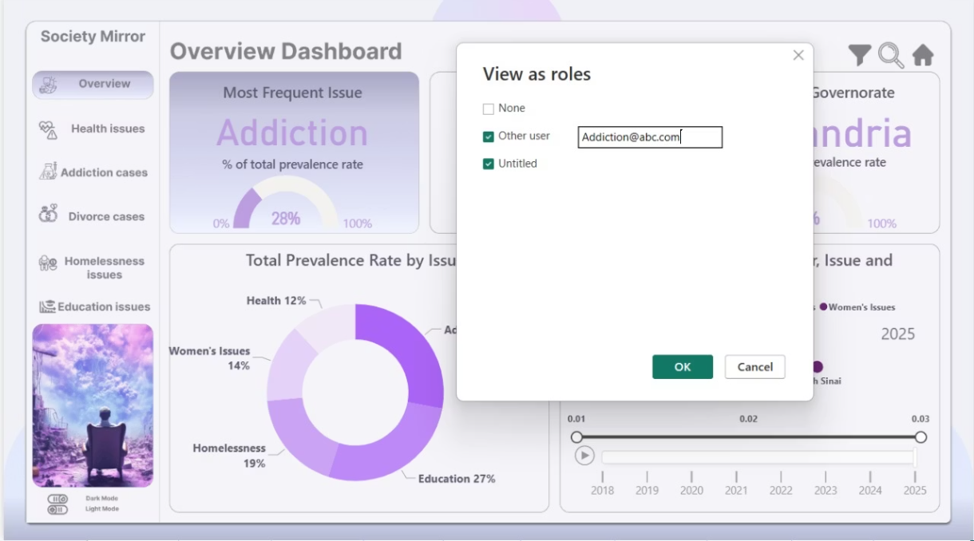
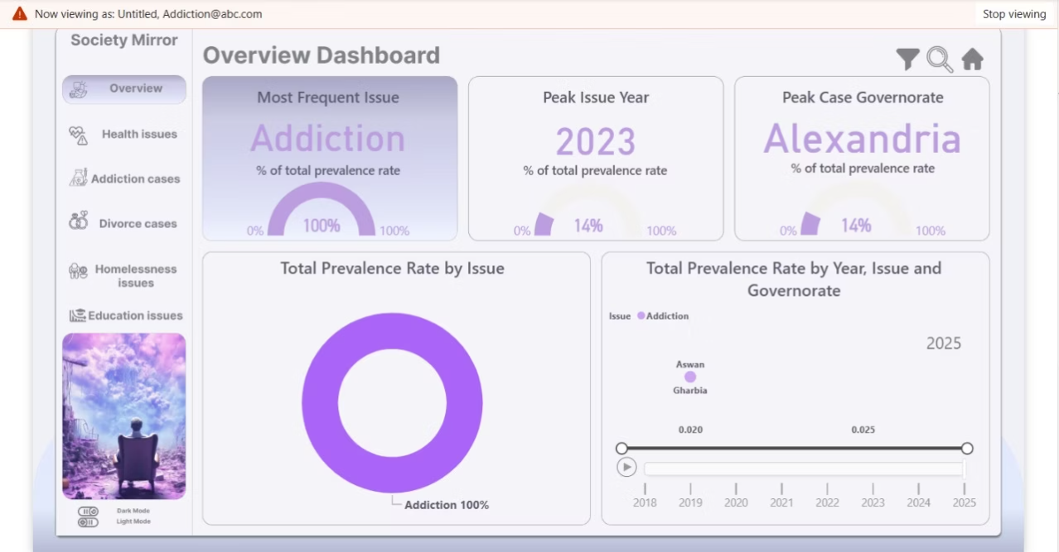
Project's features
7. Dynamic Row-Level Security (RLS) Each user sees only the issues they’re authorized to access (some users see Addiction only, others see Homelessness only). Ensures privacy, data protection, and real-world security standards.

Slide 27


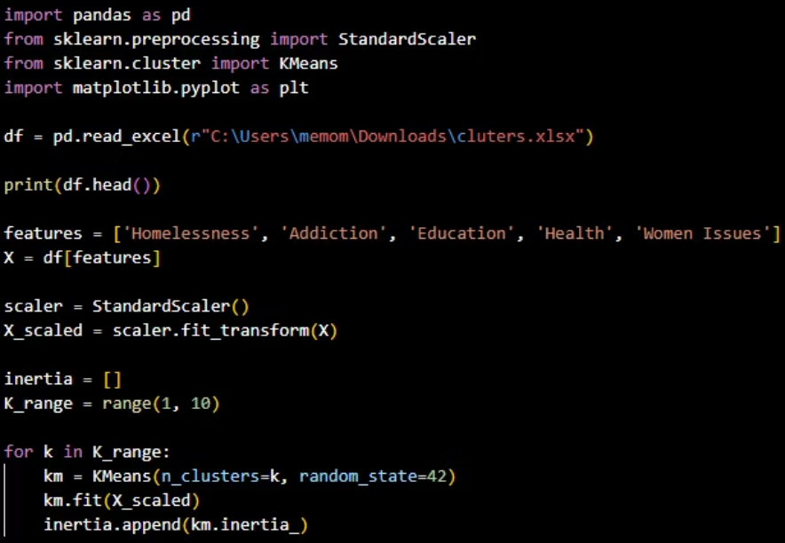
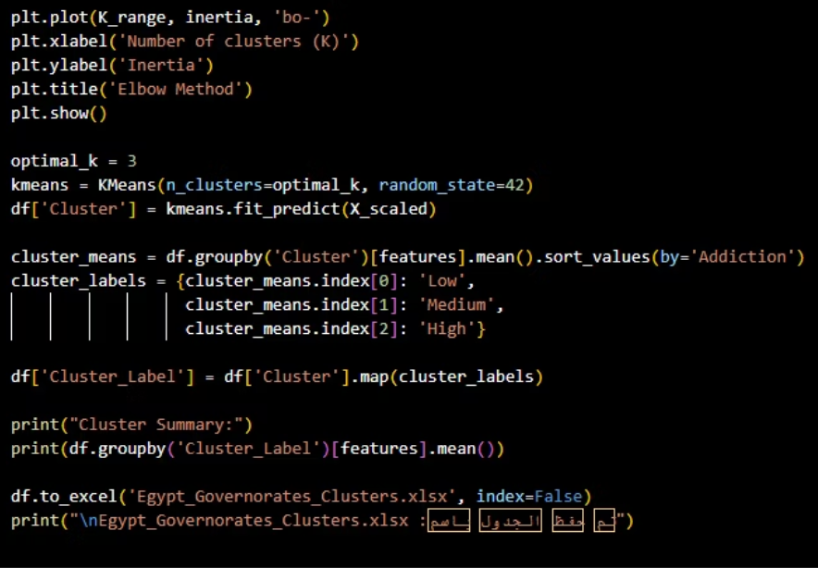
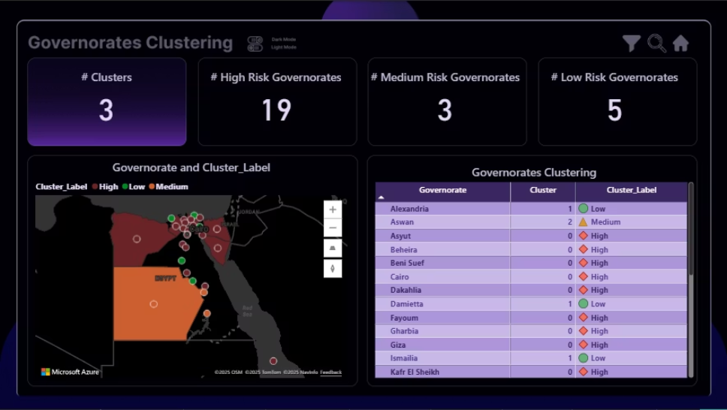
Project's features
8. K-Means Clustering Model Built a K-Means model to group governorates based on risk levels/social indicators. Visualized clusters on the map and in tables to support data-driven decisions.

Slide 28


Insights
* Healthcare: The distribution of BMI categories shows clear gender differences. Females have higher percentages in the Overweight and Obese groups, while Males are more represented in the Normal and Underweight categories.
* Divorce: Analysis of yearly trends shows that divorce cases peaked in 2023, making it the year with the highest recorded values. • Rural areas reported consistently higher divorce rates.
* Addiction: Most cases concentrated in Cairo, Giza, and Sharqia. • The data shows that male cases are significantly higher than female cases across most governorates.
* Homelessness: Highest in major cities. • The age-group analysis reveals that homelessness is most prevalent among adults (25–44), followed by teenagers (15–19). Children under 15 come next, while middle-aged individuals (45–60) represent the lowest proportion.
* Education: Enrollment decreased at 2020 during COVID-19 years. • Notable improvement from 2022 onward.

Slide 29
Recommendations
Healthcare / BMI :
• Launch targeted nutrition and lifestyle programs for women, focusing on preventing obesity.
• Promote physical-activity campaigns in workplaces and public spaces.
• Enhance early screening programs for obesity-related diseases.
• Provide more community-level health awareness sessions tailored by gender.
Education:
Homelessness :
• Strengthen digital education platforms to avoid future crisis-related dropouts.
• Establish rehabilitation and job-training programs specifically targeting adults aged 25–44.
• Increase financial support for families in governorates with low enrollment.
• Create protection and reintegration programs for teenagers to prevent long-term homelessness.
• Improve school infrastructure and teacher availability in underserved regions.
• Develop safe shelters with medical and psychological support in high density urban areas.
• Expand awareness campaigns on the importance of consistent school attendance.
• Implement tracking systems to identify at-risk individuals early.

Slide 30


Recommendations
Divorce:
Drug Addiction :
• Expand family counseling programs in rural areas, as they show consistently higher divorce rates.
• Increase the number of rehabilitation centers in high-risk governorates (Cairo, Giza, Sharqia).
• Introduce early-intervention units to help couples resolve conflicts before reaching divorce.
• Create male-focused awareness and prevention programs, since male cases dominate.
• Launch awareness campaigns highlighting the financial and social consequences of divorce.
• Offer affordable mental-health and addiction-counseling services for low income groups.
• Provide targeted support for rural communities through workshops, premarital education, and legal guidance.

Slide 31

Conclusion
In conclusion, this project is more than just numbers or tables. it’s a window to see Egypt in a new light. We gathered data from multiple sources, organized it, and transformed it into interactive insights that can make a real difference in people’s lives. Our goal wasn’t just to describe the problems, but to build a living tool that grows over time, guides decision-makers, and opens new horizons for future policies. The message we want to leave is clear: when data is understood and presented correctly, it stops being mere information… and becomes a force that can change reality and shape the future.
"Data is not just numbers; it is the key to change"

